Slide 1
The Cost of Throwing a Hard Ball Four
How Outlier Velocity Affects a Pitcher’s Command
By Alexander Harriman

Slide 2
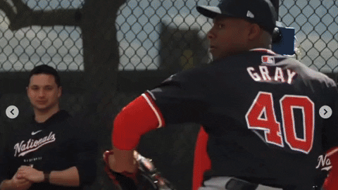
Introduction
Nationals GM Mike Rizzo made headlines in January 2024 with one line at a pre-season press event:
“I don’t care how fast you throw ball four.”

Slide 3
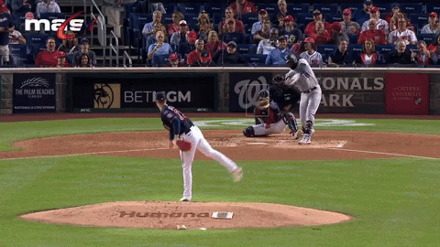
Rizzo’s Pitching Problem
For Rizzo, the comments were likely aimed at solving a few issues:
Develop one of the youngest pitching staffs in MLB in 2023
Cut down the high number of walks in 2023
Avoid allowing an MLB-high 71 home runs on pitches down the middle again

Slide 4
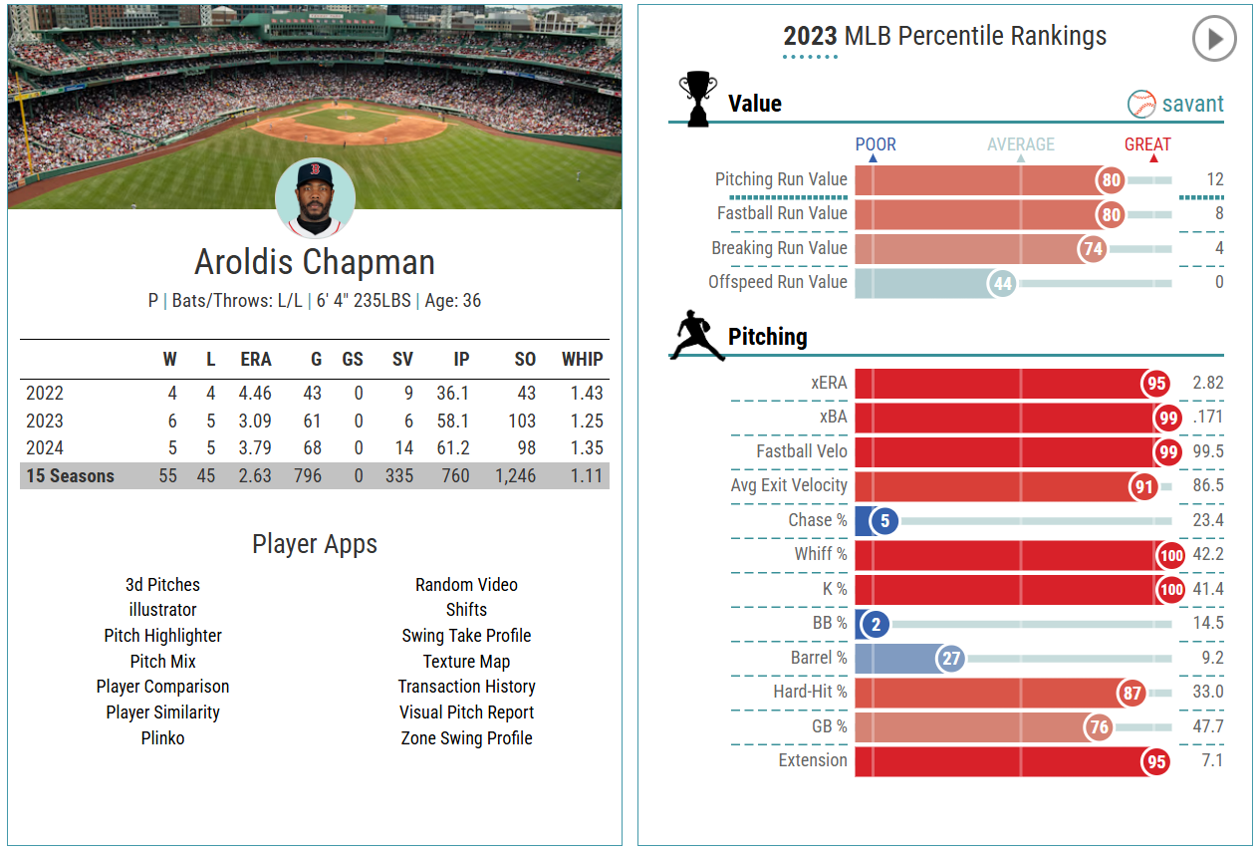
The Counterexample
Several flamethrowers generate high success rates with very little command.
For example, Aroldis Chapman has remained a top closer despite six seasons with bottom-5 percentile walk rates since 2015, including every year since 2021.

Slide 5
Does It Matter How Hard You Throw Ball Four?

Slide 6
Data Used
Data from all pitcher-seasons between 2022 and 2024 were gathered using pybaseball.
Each fastball thrown at least 500 times in its respective season was included in the study. All fastballs thrown less often and non-fastballs were excluded.
~650,000 fastballs made up the dataset.

Slide 7
Methodology
Each pitcher’s average fastball velocity was calculated so pitches could be separated into three buckets:
Average
At least 1 MPH greater than average
At least 1 MPH less than average
Choosing 1 MPH allowed ~20% of the fastballs to be faster and slower than average.

Slide 8
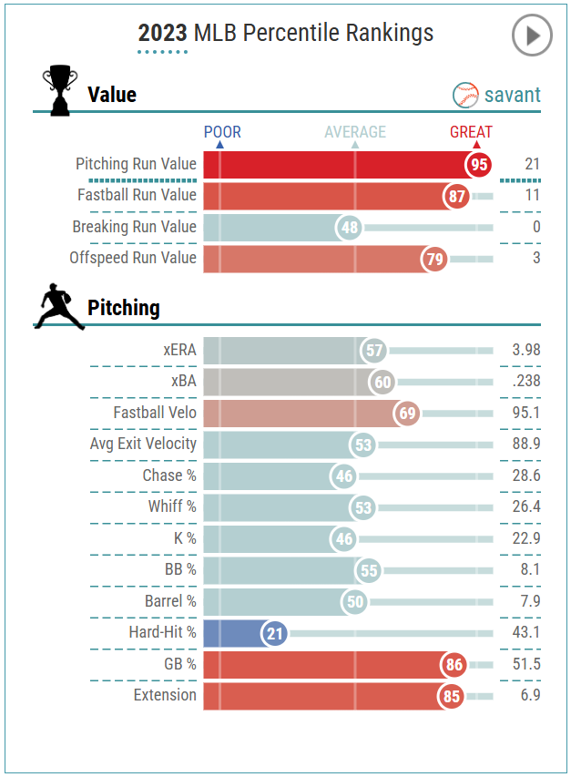
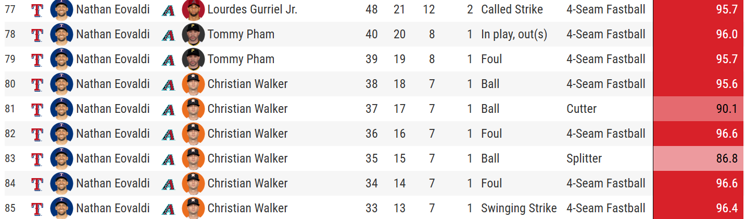
Example: Nathan Eovaldi
Pitches 82, 84, 85: Greater than 1 Bucket
Pitches 77-80: Average Bucket
Pitch 81: Not included, less than 500 cutters in 2023
Pitch 83: Not included, splitter is not a fastball

Slide 9
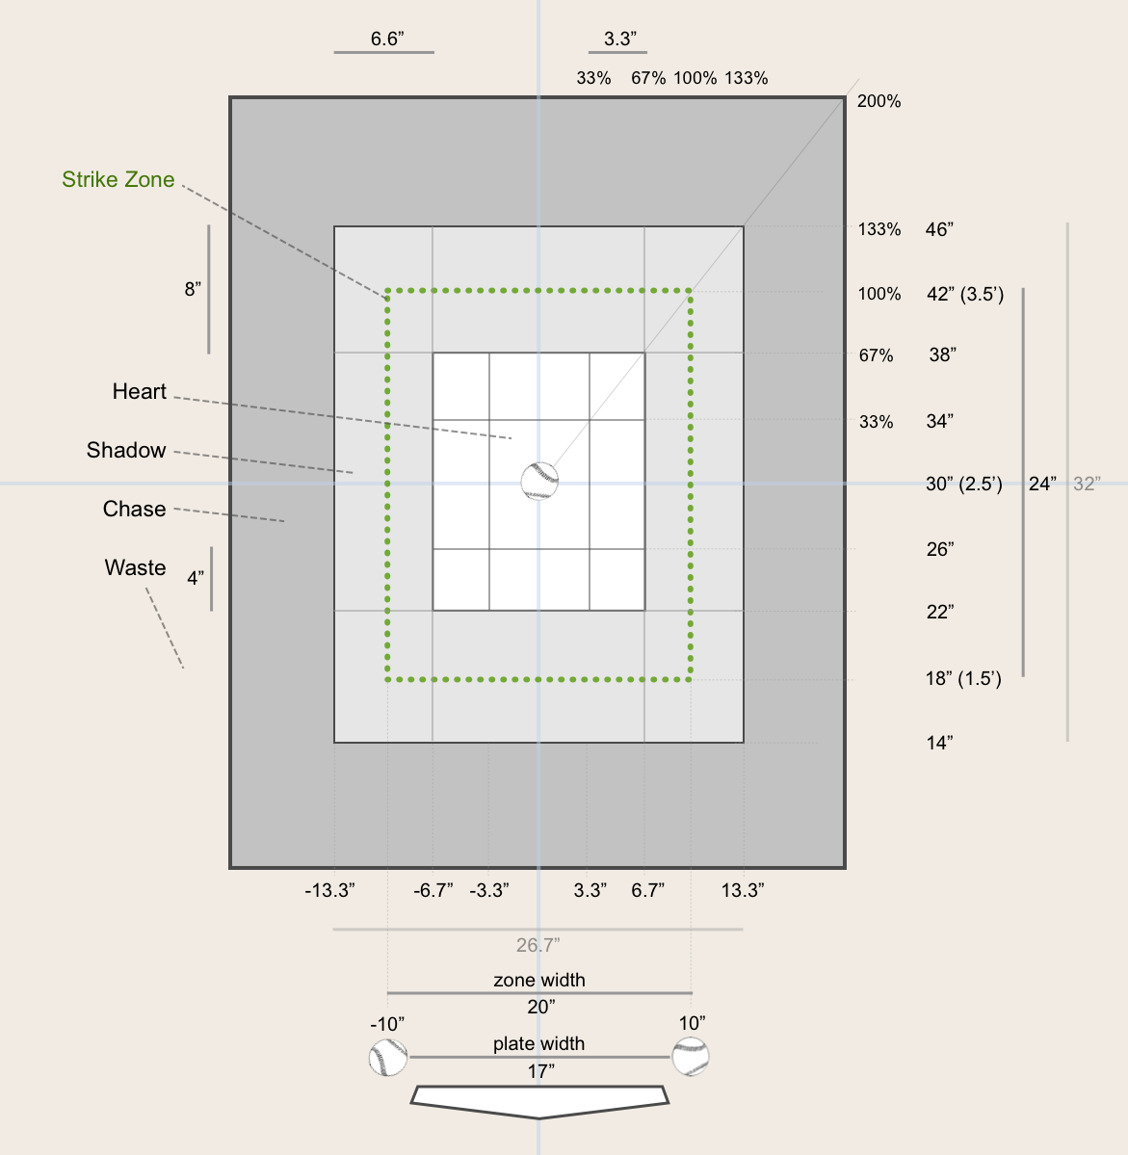
Command Metrics
After gathering all pitchers, each bucket is judged on four metrics:
In-Zone%
Heart%
Shadow%
Waste%

Slide 10
Statistical Test
An ANOVA test for each metric will determine if the average values are different between buckets.
If the test returns a p-value under 0.01, then boxplots will determine which mean is different.

Slide 11
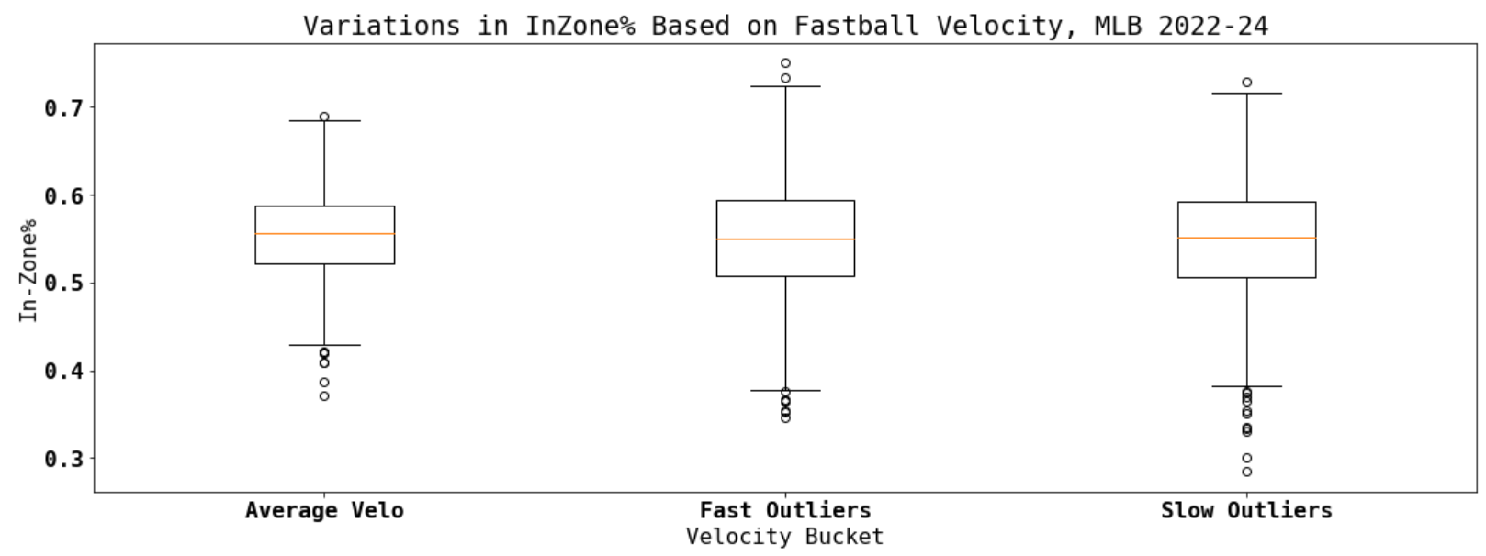
In-Zone%

Slide 12
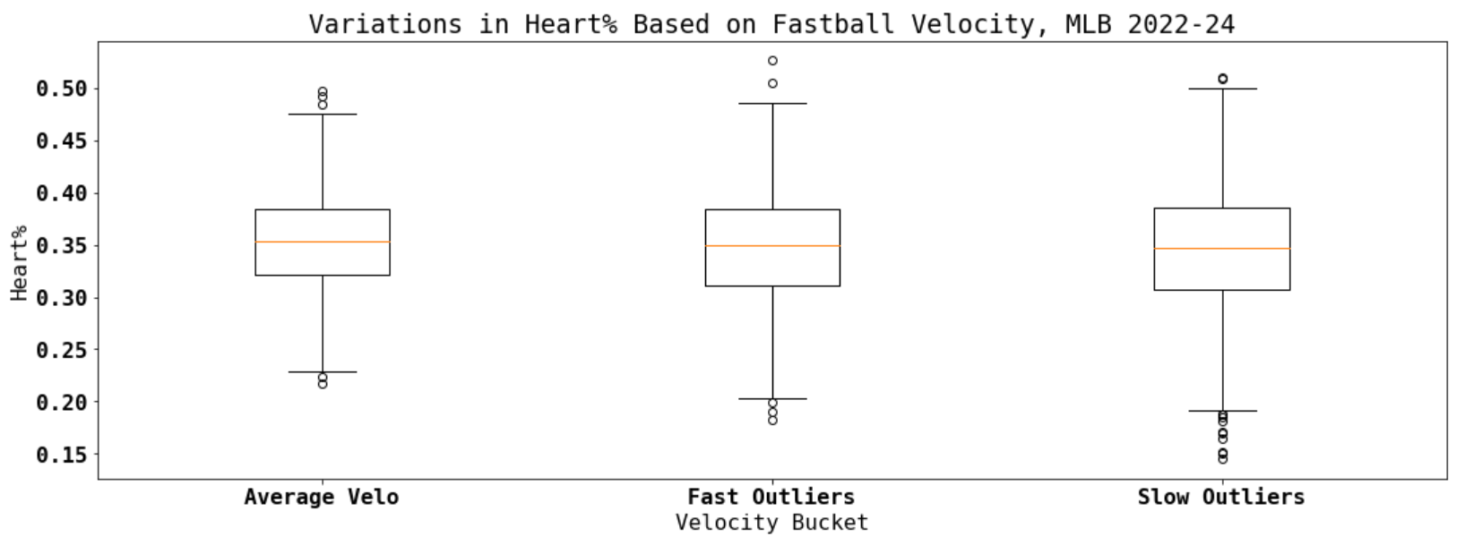
Heart%

Slide 13
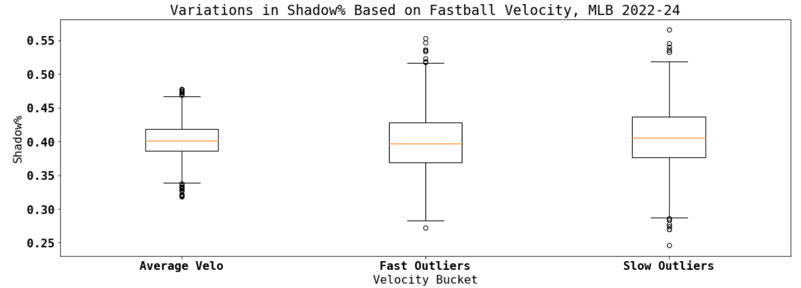
Shadow%

Slide 14
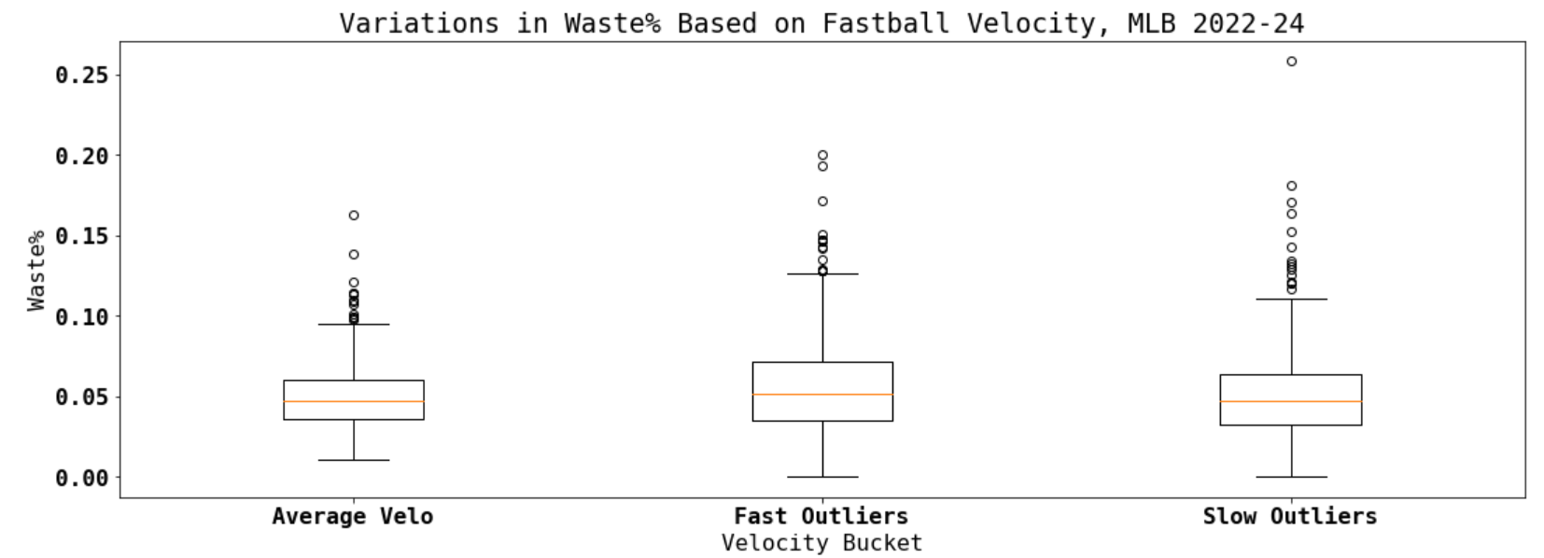
Waste%

Slide 15
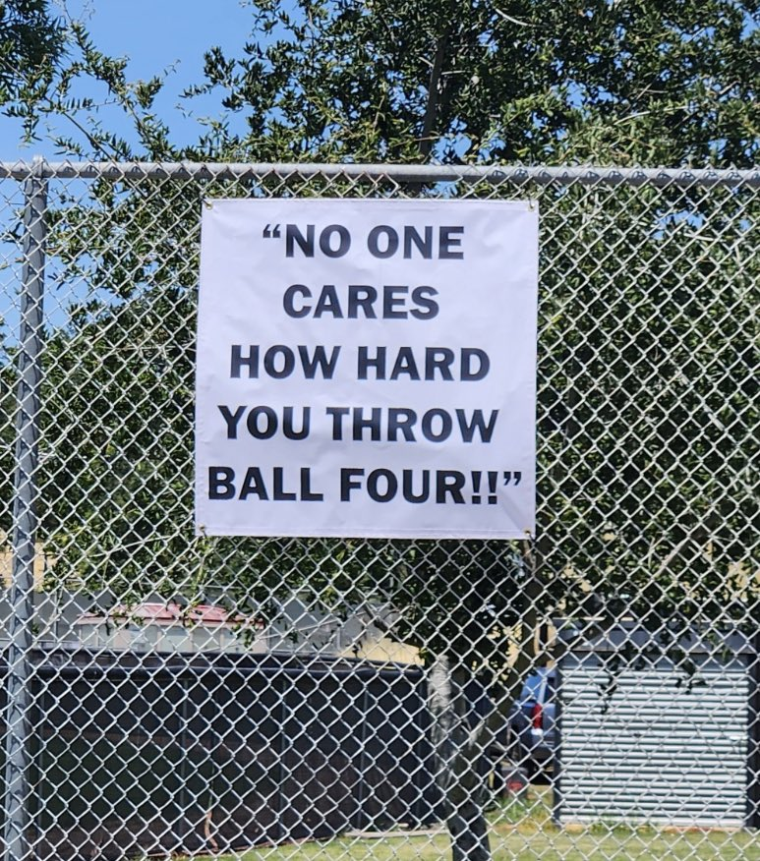
Conclusions
Outlier velocities lead to a wider range of outcomes across the board.
Throwing harder or slower than average does not lead to more in-zone pitches, but does lead to lower pitch value (more waste pitches, fewer shadow pitches)

Slide 17
Thanks!

